Slide 1
Training
SNOWFLAKE
DAY 2

Slide 2
Agenda
Objects
Pre-defined System Roles
Snowflake Users
Database Objects
ANSI and Snowflake SQL
Roles
Snowflake-Tables
Views

Slide 3
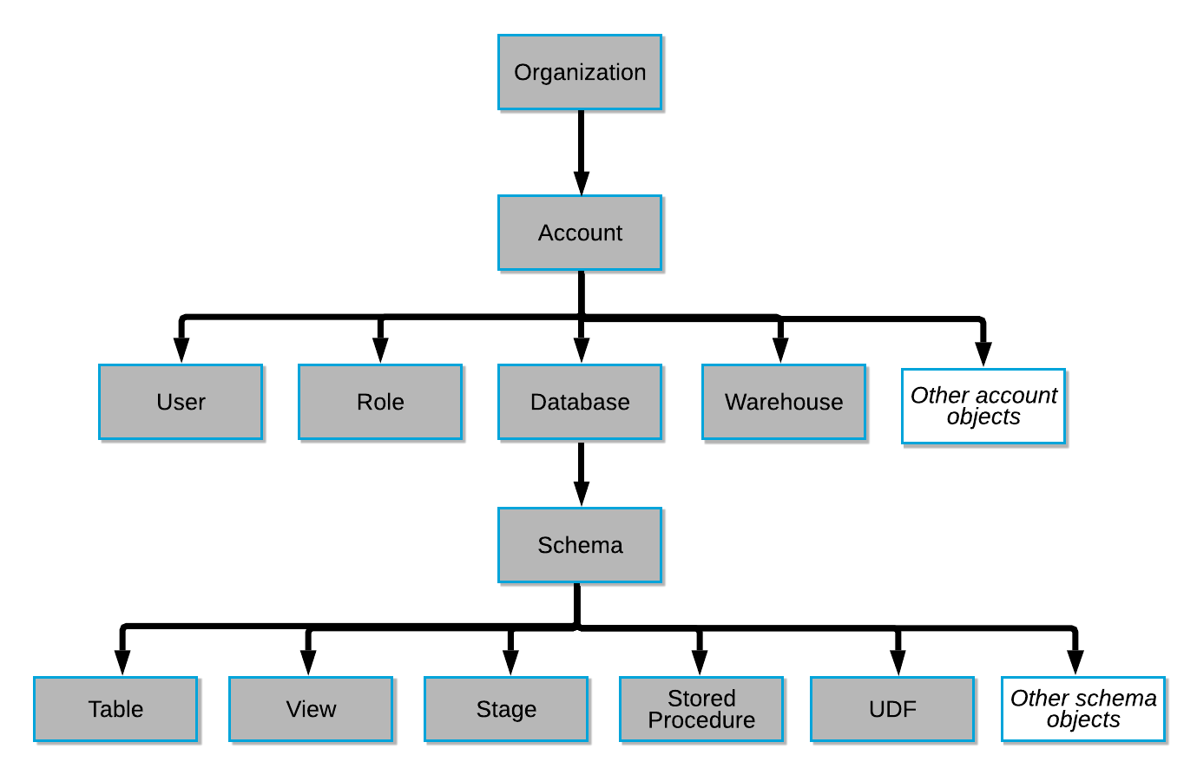
Account overview - Objects

Slide 4
Snowflake Objects
Database
Schemas
Stages
File Formats
Sequences
Pipes
Stored Procedure
User-Defined Functions
Tasks
Tables
Views

Slide 5
What is – User, Role, Warehouse, Database & Schema ?
User: A user identity recognized by Snowflake, whether associated with a person or program.
Privilege: A defined level of access to an object. Multiple distinct privileges may be used to control the granularity of access granted.
Role: An entity to which privileges can be granted. Roles are in turn assigned to users.
Warehouse: Compute Engine of Snowflake, set of Virtual Machines (VMs) provided at the
runtime to help execute a given query.
Database: Logical container for storing other objects like views or tables,
like typical Oracle/SQL Server database
Schema: Logical collection of objects which provide a good facility for managing objects and their respective accesses. After creation of a database, two schemas are created by default; public schema (any object created without specifying schema) and information schema (stores metadata information)

Slide 6
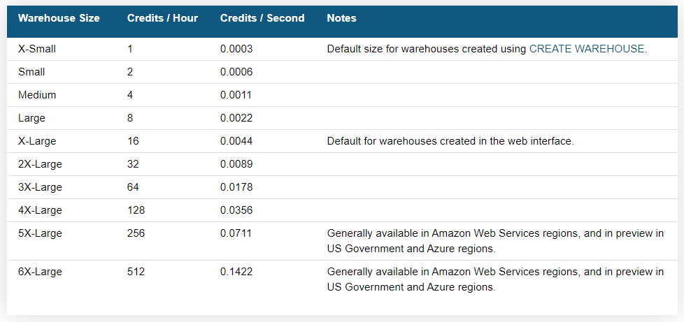
Virtual Warehouse
A virtual warehouse, often referred as a “warehouse”.
It’s a cluster of compute resources in Snowflake. A warehouse provides the required resources, such as CPU, memory, and temporary storage, to perform the following operations in a Snowflake session.
A virtual warehouse is available in two types:
Standard
Snowpark-optimized

Slide 7
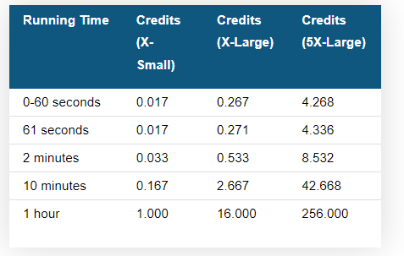
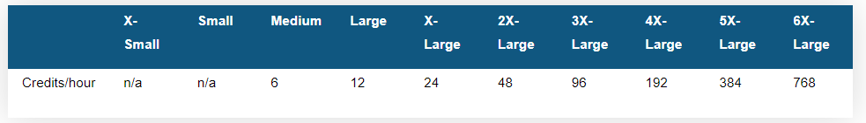
Virtual Warehouse
Credit Pricing varies with CLOUD provider and EDITION of Snowflake.
For more details -> https://www.snowflake.com/pricing/
SNOWPARK – OPTIMIZED WAREHOUSE

Slide 8
Tables
Temporary –
Once the session ends, data cannot be retrieved by anyone
Have time-travel feature. (Time Travel Retention Period - 0/1 default-1 day)
Transient –
Transitory data is maintained beyond each session
Exists until explicitly dropped
Available to all users with appropriate privileges
Can be cloned as transient or temporary tables
Have time-travel feature but no fail-safe. (Time Travel Retention Period - 0/1 default-1 day)
Permanent (default) –
Provides additional level of data protection and recovery.
Can be cloned as permanent, transient or temporary tables.
Have time-travel but dependent on Edition
Only exists in the session it is created in and not visible to other sessions/users
Has fail-safe feature .
Standard Edition (Time Travel Retention Period - 0/1 default-1 day)
Enterprise Edition/ higher (Time Travel Retention Period – 0 to 90 default-1 day)

Slide 9
Table Syntax
Temporary Table :-
Syntax: Create Temporary Table <tablename>(<colname> <datatype>, <colname> <datatype>)
Example: create temporary table temp_table_demo ( name varchar, age int, score int );
Transient Table :-
Syntax: Create Transient Table <tablename>(< colname > <datatype>, < colname > <datatype>)
Example: create transient table temp_table_demo ( name varchar, age int, score int );
Permanent Table :-
Syntax: Create Table <tablename>(< colname > <datatype>, < colname > <datatype>)
Example: create table temp_table_demo ( name varchar, age int, score int );
Note*:
Tables with same names but different types can be created in the same database and schema.
Create Table documentation

Slide 10
Views
A view allows the result of a query to be accessed as if it were a table. Views serve a variety of purposes, including combining, segregating, and protecting data.
Non- Materialized Views (Standard) – Created by executing the query at the time that the view is referenced in a query. The results are not stored for future use. Performance is slower than with materialized views.
Syntax: create view <view_name>
II. Materialized Views – Pre-computed dataset derived from a query specification, stored for later use. Behaves more like a table: This allows faster access, but requires storage space and active maintenance, both of which incur additional costs. Materialized views have some restrictions that non-materialized views do not have.
Syntax: create materialized view <m_viewname>
Secure Views – Both non-materialized and materialized views can be defined as secure.
Secure views have advantages over standard views, including improved data privacy and data sharing. They also have some performance impacts to take into consideration.
Syntax: create secure view <secure_view_name>

Slide 11
ANSI and Snowflake SQL
SQL is a structured query language which helps in storing, accessing the stored data and manipulating the data in the database.
SQL is based on ANSI standard.
ANSI stands for American National Standards Institute. SQL is built such that its syntax are simple and language almost similar to English language.
Snowflake provides the ability to query all their data using ANSI compliant SQL . However, Snowflake goes beyond basic SQL, delivering sophisticated analytic and windowing functions as part of our data warehouse service.
Functions like CUME_DIST, DENSE_RANK, FIRST_VALUE, LAG, LAST_VALUE, LEAD, NTILE, PERCENT_RANK, RANK, ROW_NUMBER

Slide 12
Snowflake supports not only analytic windowing functions, but all the other features you would expect in SQL.
This includes but is not limited to general aggregation functions (e.g., sum), nested virtual tables, sub queries, order by, and group by.
In additional to general aggregation functions, we also have bitwise aggregation functions, linear regressions functions and cardinality estimation functions (i.e., HyperLogLog)
If your existing queries are written with standard SQL, they will run in Snowflake, and you can apply all these functions to your semi-structured data natively using Snowflake.

